Slide 1

Biological Databases: Theories and Practice
430032
Application Design and Database Connection
Instructor: Prof. LEE, Tzong-Yi (李宗夷)
Email: leetzongyi@nycu.edu.ctw
Professor
Institute of Bioinformatics and Systems Biology,
National Yang Ming Chiao Tung University
结合传统与现代
融会中国与西方

Slide 2
Outline
Application Programs and User Interfaces
Web Fundamentals
Application Architectures
HyperText Transfer Protocol (HTTP)
HyperText Markup Language (HTML)
Web server programming - PHP
Introduction of PHP programing
Notes:
1

Slide 3
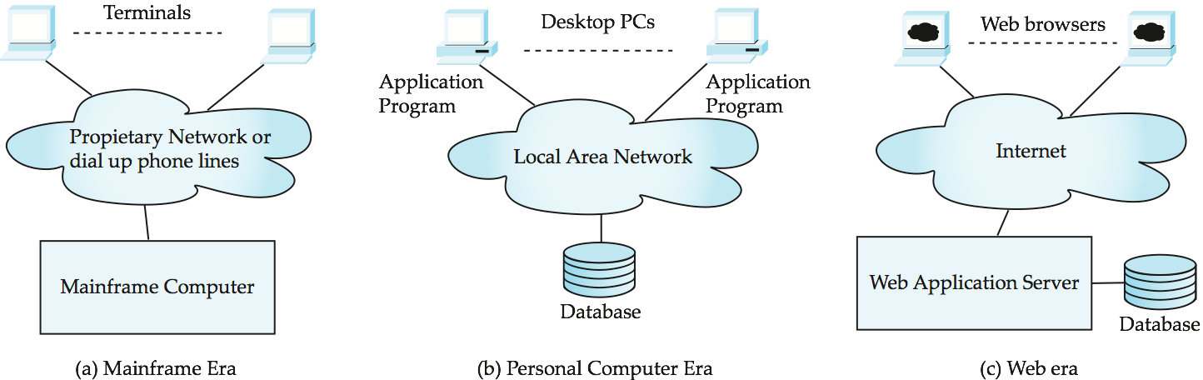
Application Programs and User Interfaces
Most database users do not use a query language like SQL
An application program acts as the intermediary between users and the database
Applications split into
front-end
middle layer
backend
Front-end: user interface
Forms for data query
Graphical user interfaces (GUI)
Mostly web-based interfaces

Slide 4
Web Interface
Web browsers have become the de-facto standard user interface to databases
Enable large numbers of users to access databases from anywhere
Avoid the need for downloading/installing specialized code, while providing a good graphical user interface
Javascript, Flash and other scripting languages run in browser, but are downloaded transparently
Examples: banks, airline and rental car reservations, university course registration and grading, an so on.

Slide 5
The World Wide Web
The Web is a distributed information system based on hypertext.
Most Web documents are hypertext documents formatted via the HyperText Markup Language (HTML)
HTML documents contain
text along with font specifications, and other formatting instructions
hypertext links to other documents, which can be associated with regions of the text.
forms, enabling users to enter data which can then be sent back to the Web server

Slide 6
Uniform Resources Locators
In the Web, functionality of pointers is provided by Uniform Resource Locators (URLs).
URL example:
https://www.nycu.edu.tw/ or http://140.113.118.199/~NYCU-BiOmicsLab/
The first part indicates how the document is to be accessed
“http” indicates that the document is to be accessed using the Hyper Text Transfer Protocol.
The second part gives the unique name of a machine on the Internet.
The rest of the URL identifies the document within the machine.
The local identification can be:
The path name of a file on the machine, or
An identifier (path name) of a program, plus arguments to be passed to the program
E.g., http://www.google.com/search?q=silberschatz

Slide 7
HTML and HTTP
DNS server
nycu.edu.tw
HTML provides formatting, hypertext link, and image display features
including tables, stylesheets (to alter default formatting), etc.
HTML also provides input features
Users input and send request to the server, and the server will return the front page content to the user browser.
HyperText Transfer Protocol (HTTP) used for communication with the Web server
dns.nycu.edu.tw
140.113.1.1
Web Server
HTTP Request
Front page
140.113.118.199

Slide 8
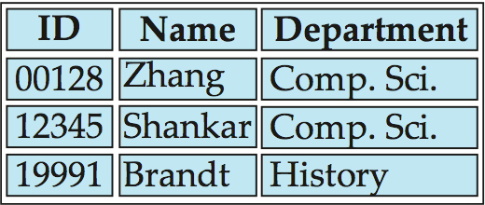
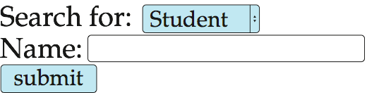
Sample HTML Source Text
<html>
<body>
<table border=1> <tr><th>ID</th><th>Name</th><th>Department</th></tr> <tr> <td>00128</td> <td>Zhang</td> <td>Comp. Sci.</td> </tr> ….
</table>
<form action="PersonQuery" method=get> Search for: <select name="persontype"> <option value="student" selected>Student </option> <option value="instructor"> Instructor </option> </select> <br> Name: <input type=text size=20 name="name"> <input type=submit value="submit">
</form>
</body> </html>

Slide 9
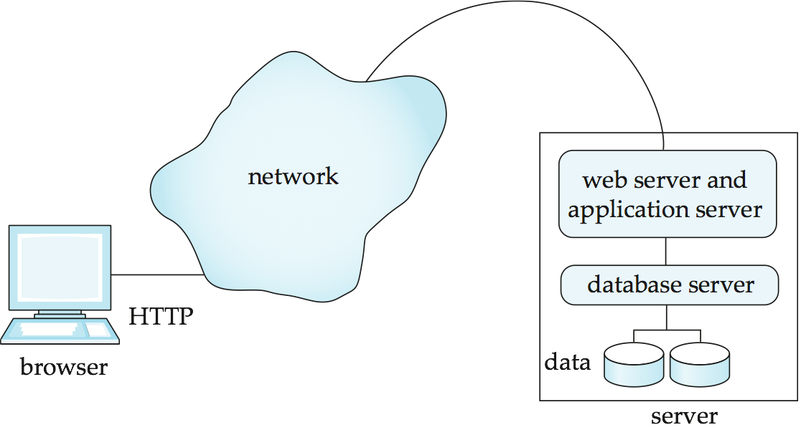
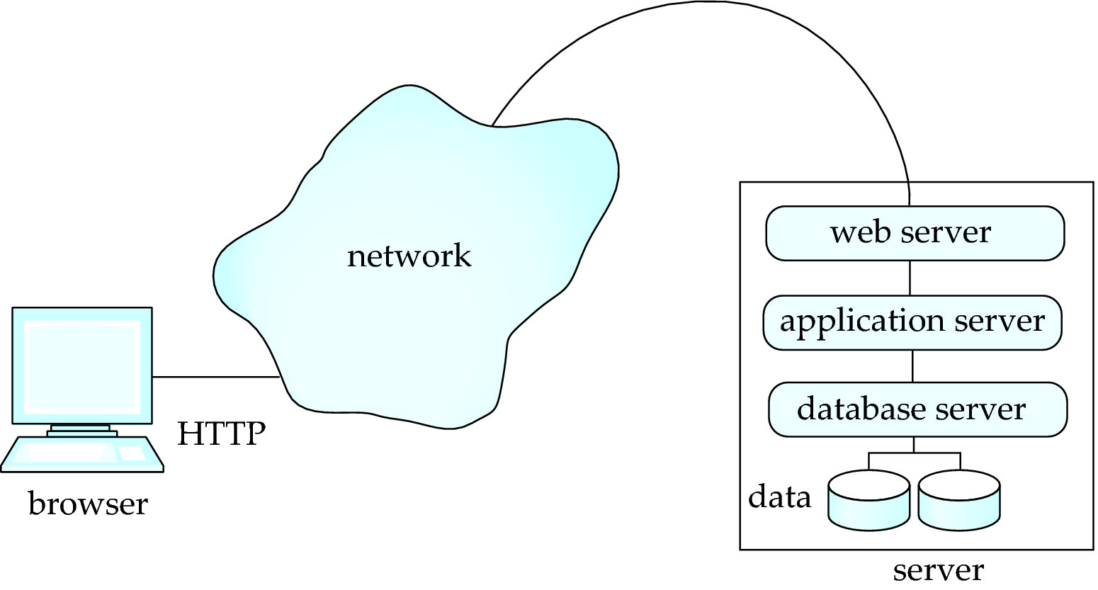
Web Servers
A Web server can easily serve as a front end to a variety of information services.
When an HTTP server receives a request for such a document, it executes the program, and sends back the HTML document that is generated.
Common Gateway Interface (CGI): a standard protocol for web servers to execute programs and send data back to users.
Two-Layer Web Architecture
Three-Layer Web Architecture

Slide 10
Web server programming - PHP
PHP is widely used for Web server scripting language embedded into HTML.
Extensive libraries included for database access using ODBC
Example:
<html>
<head> <title> Hello </title> </head>
<body>
<?php
if (!isset($_GET[‘name’]))
{ echo “Hello World”; }
else { echo “Hello, ” + $_GET[‘name’]; }
?>
</body>
</html>

Slide 11
HTML
Reference manual: https://www.w3schools.com/html/
Basic structure of HTML
<HTML>
<HEAD>
<TITLE>Sample HTML</TITLE>
</HEAD>
<BODY>
Hello WWW!
………
</BODY>
</HTML>
Main HTML content

Slide 12
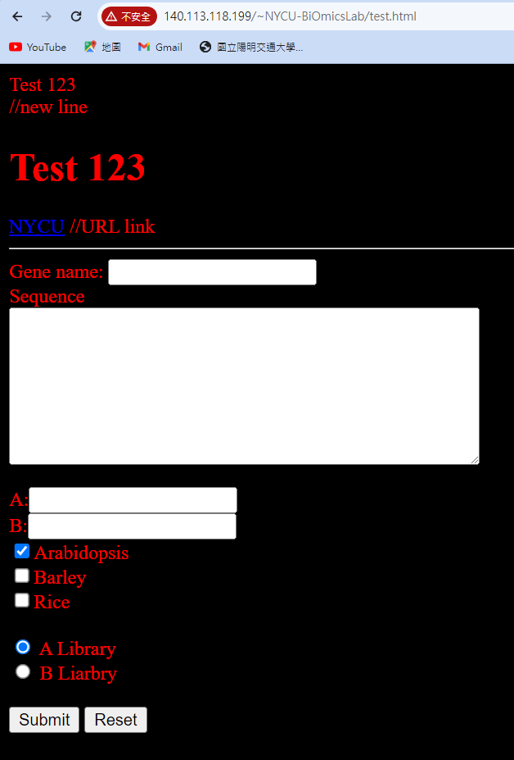
Example: http://140.113.118.199/~NYCU-BiOmicsLab/test.html
<html>
<head>
<title>HTML Test Page</title>
</head>
<body text="red" bgcolor="#000000">
Test 123 <br> //new line
<H1>Test 123</H1>
<a href=‘http://www.cuhk.edu.cn’>CUHK</a> //URL link
<hr>
<form id="form“ method="get“ action="result.php">
Gene name: <input name="seq_name" type="text"><br>
Sequence <br>
<textarea name="sequence" cols="50" rows="8">
</textarea> <br><br>
………………….
………………….
</form>
</body>
</html>

Slide 13
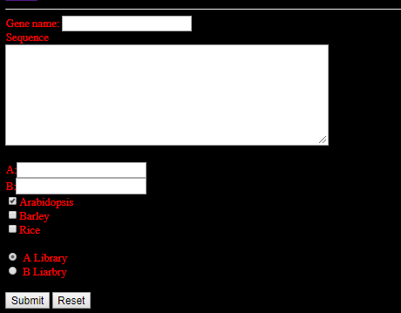
Example: http://140.113.118.199/~NYCU-BiOmicsLab/test.html
<form id="form" method="get" action="result.php">
Gene name: <input name="seq_name" type="text" ><br>
Sequence <br>
<textarea name="sequence" cols="50" rows="8"> </textarea> <br><br>
A:<input name="a_value" type="text"><br>
B:<input name="b_value" type="text"><br>
<input name="arab" type="checkbox" value="ON" checked="checked">Arabidopsis <br>
<input name="barley" type="checkbox" value="ON">Barley<br>
<input name="rice" type="checkbox" value="ON">Rice<br><br>
<input name="library" type="radio" value="A" checked="checked"> A Library<br>
<input name="library" type="radio" value="B"> B Liarbry
<br><br>
<INPUT TYPE="SUBMIT" VALUE="Submit" NAME="submit">
<INPUT TYPE="RESET" VALUE="Reset" NAME="reset">
</form>

Slide 14
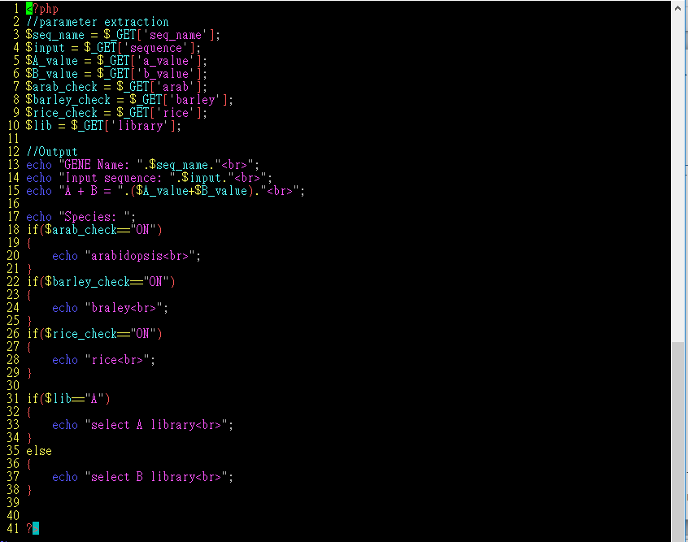
result.php

Slide 15
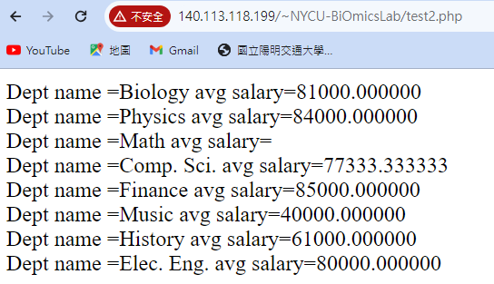
PHP program connecting to MySQL
Example:
<?php
mysqli_report(MYSQLI_REPORT_ERROR | MYSQLI_REPORT_STRICT);
$link = mysqli_connect("localhost", "student", "student", "Practice");
$query = "SELECT * from instructor";
$result = mysqli_query($link,"SELECT * from instructor");
while ($row = mysqli_fetch_row($result))
{
echo "ID =".$row[0]."<br>\n";
}
mysqli_close($mysqli);
?>
\\Database connection
\\SQL sentence
\\SQL execution
\\Fetch query results row by row
\\print out the results
\\Database connection closed

Slide 16
Introduction of PHP programming
PHP (recursive acronym for PHP: Hypertext Preprocessor) is a widely-used open source general-purpose scripting language that is especially suited for web development and can be embedded into HTML.
Techniques for programming dynamic features into Web
Open source scripting language
Available on most computer platforms
The best things in using PHP are that it is extremely simple for a newcomer, but offers many advanced features for a professional programmer.

Slide 17
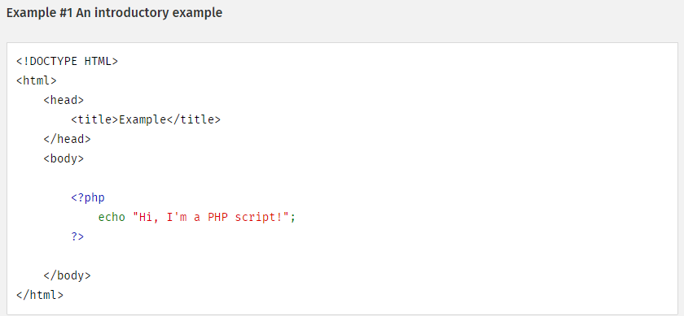
Embedded into HTML
PHP Reference manual: http://php.net/manual/en/index.php

Slide 18
What can PHP do?
Anything.
What distinguishes PHP from something like client-side JavaScript is that the code is executed on the server, generating HTML which is then sent back to the client.
PHP is mainly focused on server-side scripting, so you can do anything any other CGI program can do, such as collect form data, generate dynamic page content, or send and receive cookies.
But PHP can do much more.

Slide 19
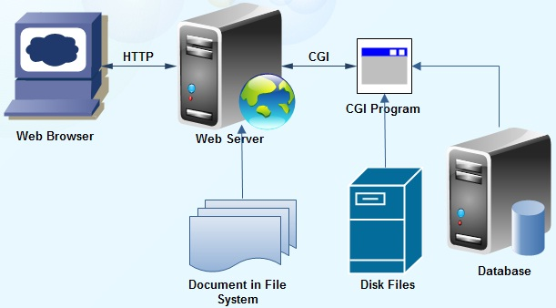
Common Gateway Interface (CGI)
PHP is a sort of common gateway interface (CGI).
PHP or JSP

Slide 20
Three main areas where PHP scripts are used
Server-side scripting
This is the most traditional and main target field for PHP.
Command line scripting
You can make a PHP script to run it without any server or browser.
Writing desktop applications
PHP is probably not the very best language to create a desktop application with a graphical user interface, but if you know PHP very well, you can also use PHP-GTK to write such programs.

Slide 21
Get started
When PHP parses a file, it looks for opening and closing tags, which are <?php and ?> which tell PHP to start and stop interpreting the code between them.
Comments: // or /* … */
Get system information from PHP
<?php phpinfo(); ?>
We are going to check what sort of browser the visitor is using.
<?php echo $_SERVER['HTTP_USER_AGENT']; ?>

Slide 22
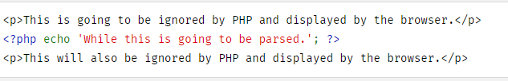
Escaping from HTML
Everything outside of a pair of opening and closing tags is ignored by the PHP parser which allows PHP files to have mixed content. This allows PHP to be embedded in HTML documents, for example to create templates.

Slide 23
Mixing both HTML and PHP modes
<?php if (strpos($_SERVER['HTTP_USER_AGENT'], 'MSIE') !== FALSE) { ?>
<h3>strpos() must have returned non-false</h3> <p>You are using Internet Explorer</p>
<?php } else { ?>
<h3>strpos() must have returned false</h3> <p>You are not using Internet Explorer</p>
<?php } ?>

Slide 24
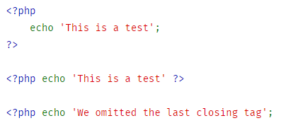
Instruction separation
As in C or Perl, PHP requires instructions to be terminated with a semicolon at the end of each statement. The closing tag of a block of PHP code automatically implies a semicolon; you do not need to have a semicolon terminating the last line of a PHP block. The closing tag for the block will include the immediately trailing newline if one is present.

Slide 25
Variable types
http://php.net/manual/en/language.types.php
PHP supports nine primitive types.
Four scalar types:
boolean
integer
float (floating-point number, aka double)
string
Three compound types:
array
object
callable
And finally two special types:
resource
NULL

Slide 26
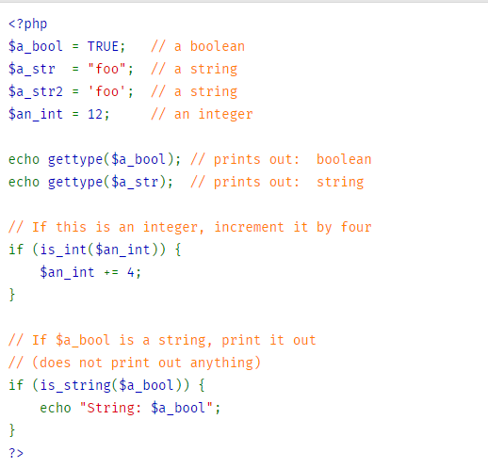

Slide 27
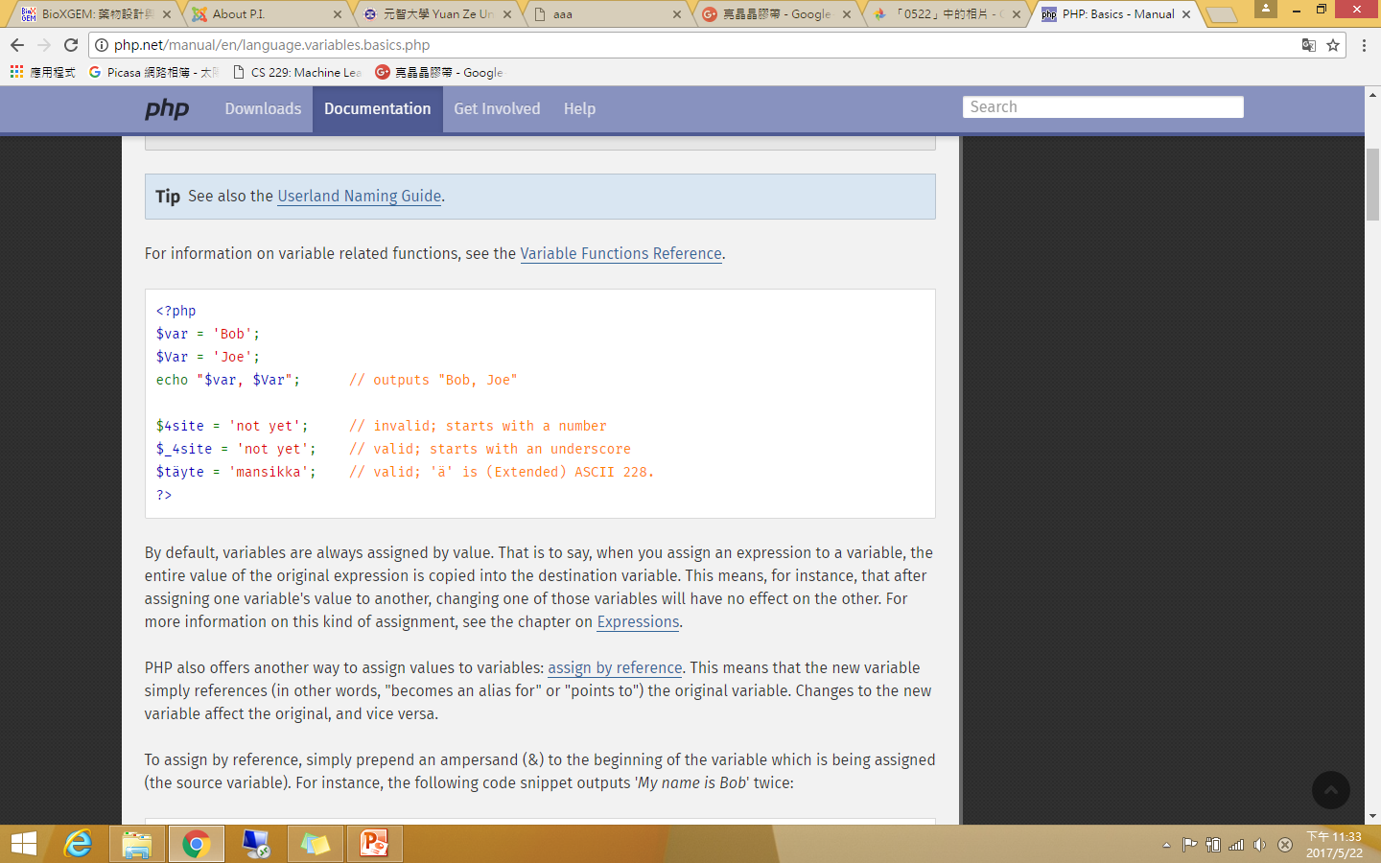
Variables
Variables in PHP are represented by a dollar sign ($) followed by the name of the variable. The variable name is case-sensitive.
Variable name can include characters, letters, and underscore character (_)
Main ways to express strings and text
Single-quoted strings or double-quoted strings

Slide 28
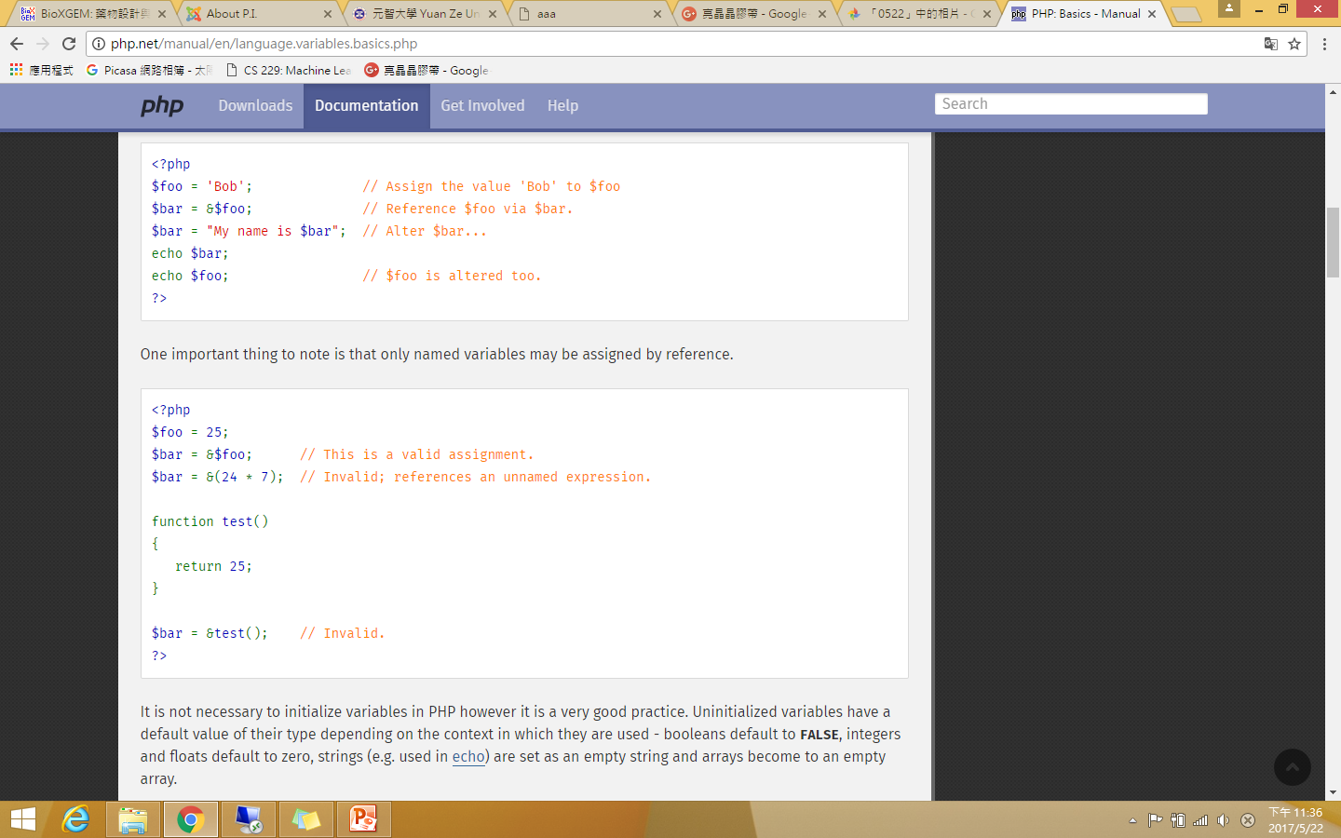
Assign by reference
PHP also offers another way to assign values to variables: assign by reference. This means that the new variable simply references (in other words, "becomes an alias for" or "points to") the original variable. Changes to the new variable affect the original, and vice versa.

Slide 29
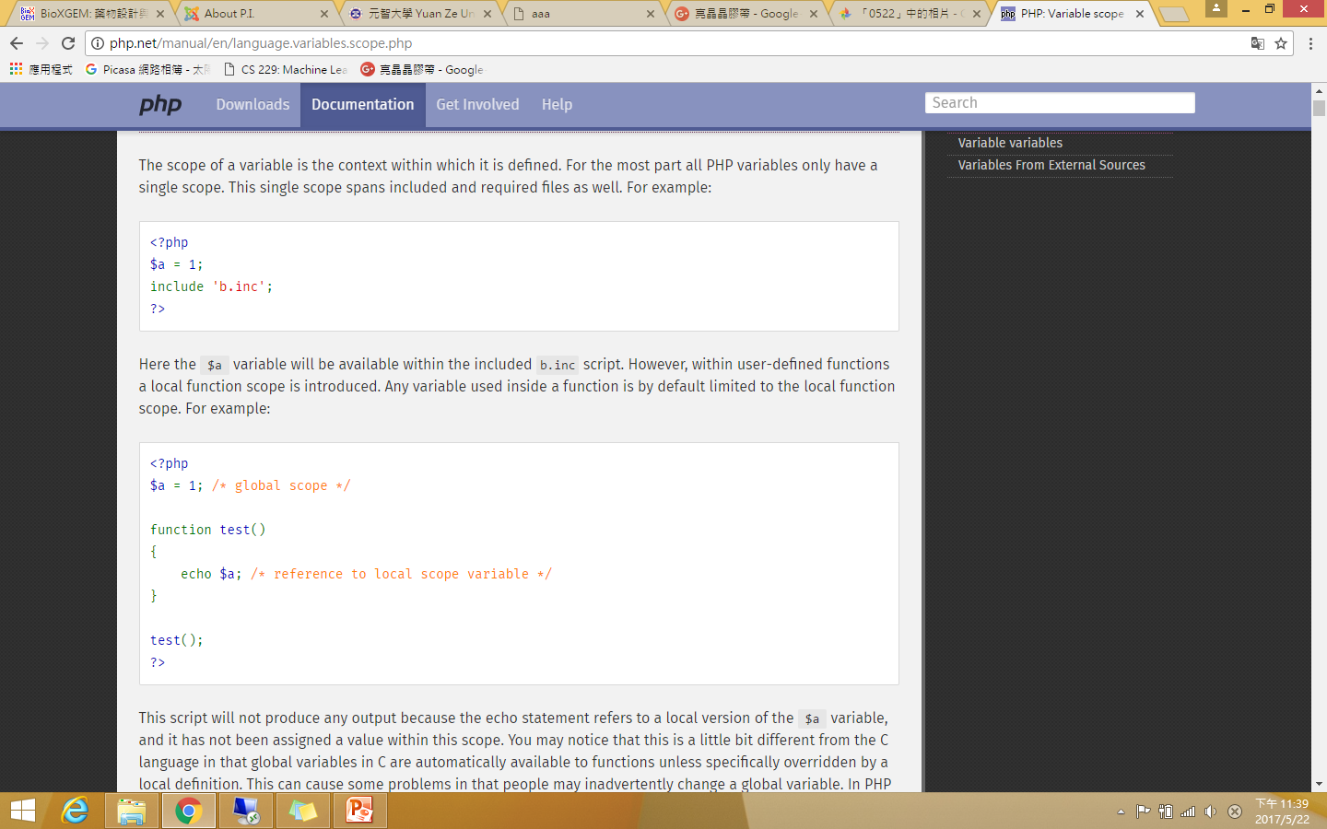
Variable scope
The scope of a variable is the context within which it is defined. For the most part all PHP variables only have a single scope. This single scope spans included and required files as well.
Here the $a variable will be available within the included b.inc script.

Slide 30
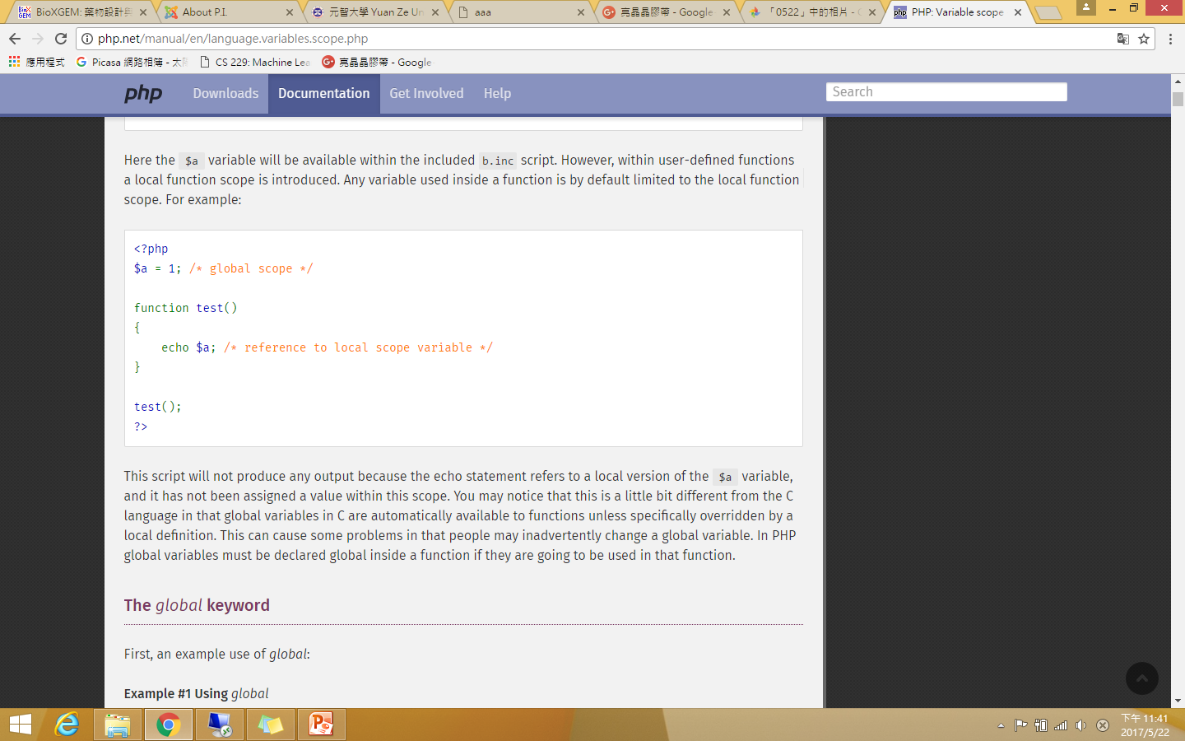
Local variables
However, within user-defined functions a local function scope is introduced. Any variable used inside a function is by default limited to the local function scope.
This script will not produce any output because the echo statement refers to a local version of the $a variable, and it has not been assigned a value within this scope.

Slide 31
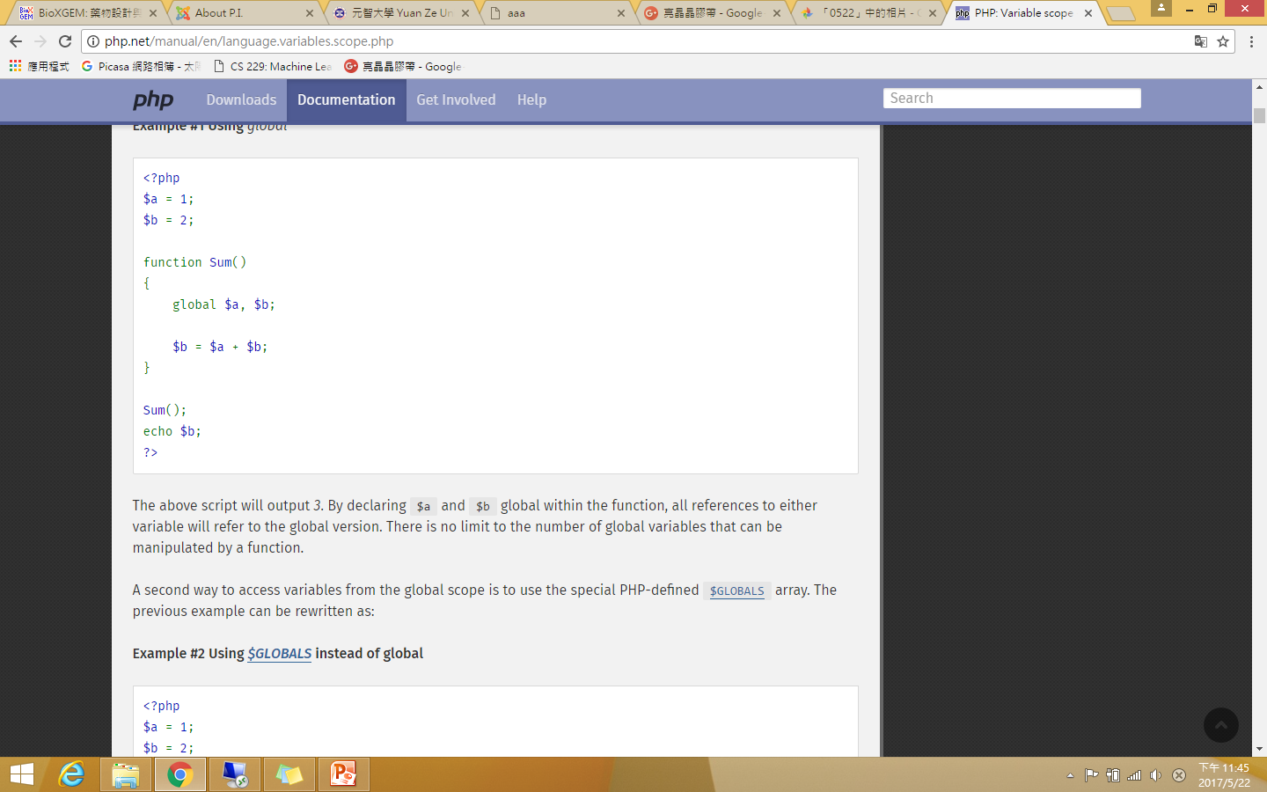
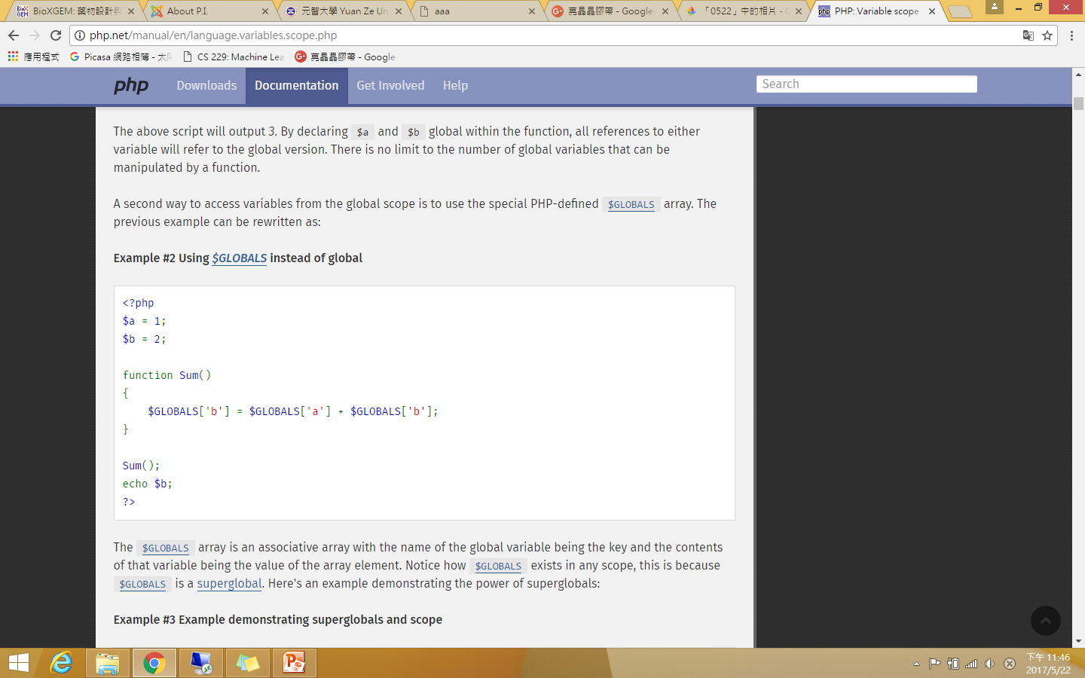
Global variables
Case 1:
Case 2:
The $GLOBALS array is an associative array with the name of the global variable being the key and the contents of that variable being the value of the array element. Notice how $GLOBALS exists in any scope, this is because $GLOBALS is a superglobal.
The above script will output 3. By declaring $a and $b global within the function, all references to either variable will refer to the global version.

Slide 32

Variable variables
Sometimes it is convenient to be able to have variable variable names. That is, a variable name which can be set and used dynamically.

Slide 33
PHP arrays
Numeric array
Associates a numeric index with each element in the array
Indexes are integer numbers
Start at zero
Grow incrementally
Associative array
Provides pairs of (key => value) elements
An array can be created using the array() language construct.
array(
key => value,
key2 => value2,
key3 => value3,
...
)

Slide 34
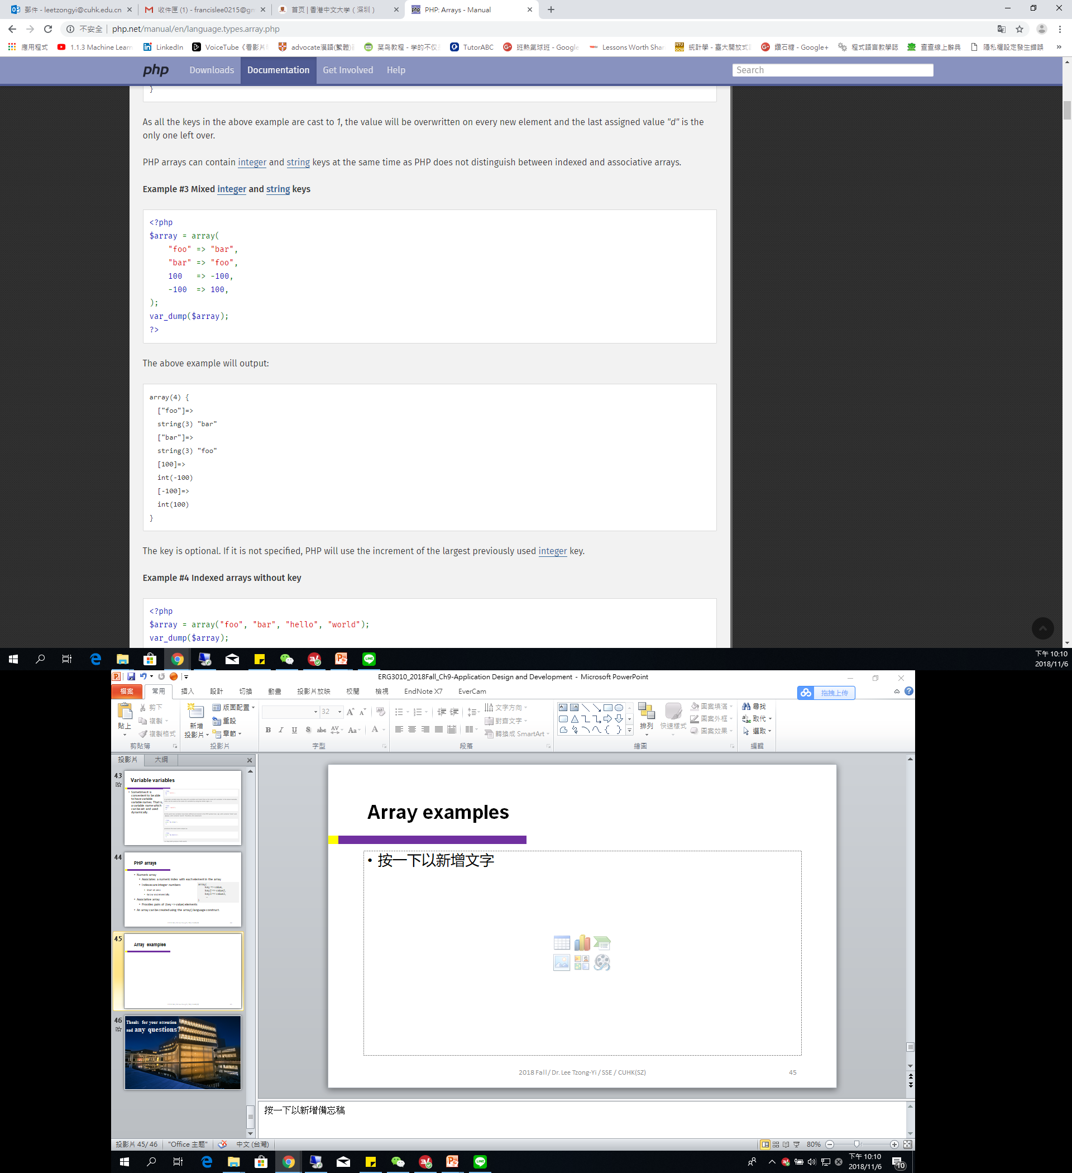
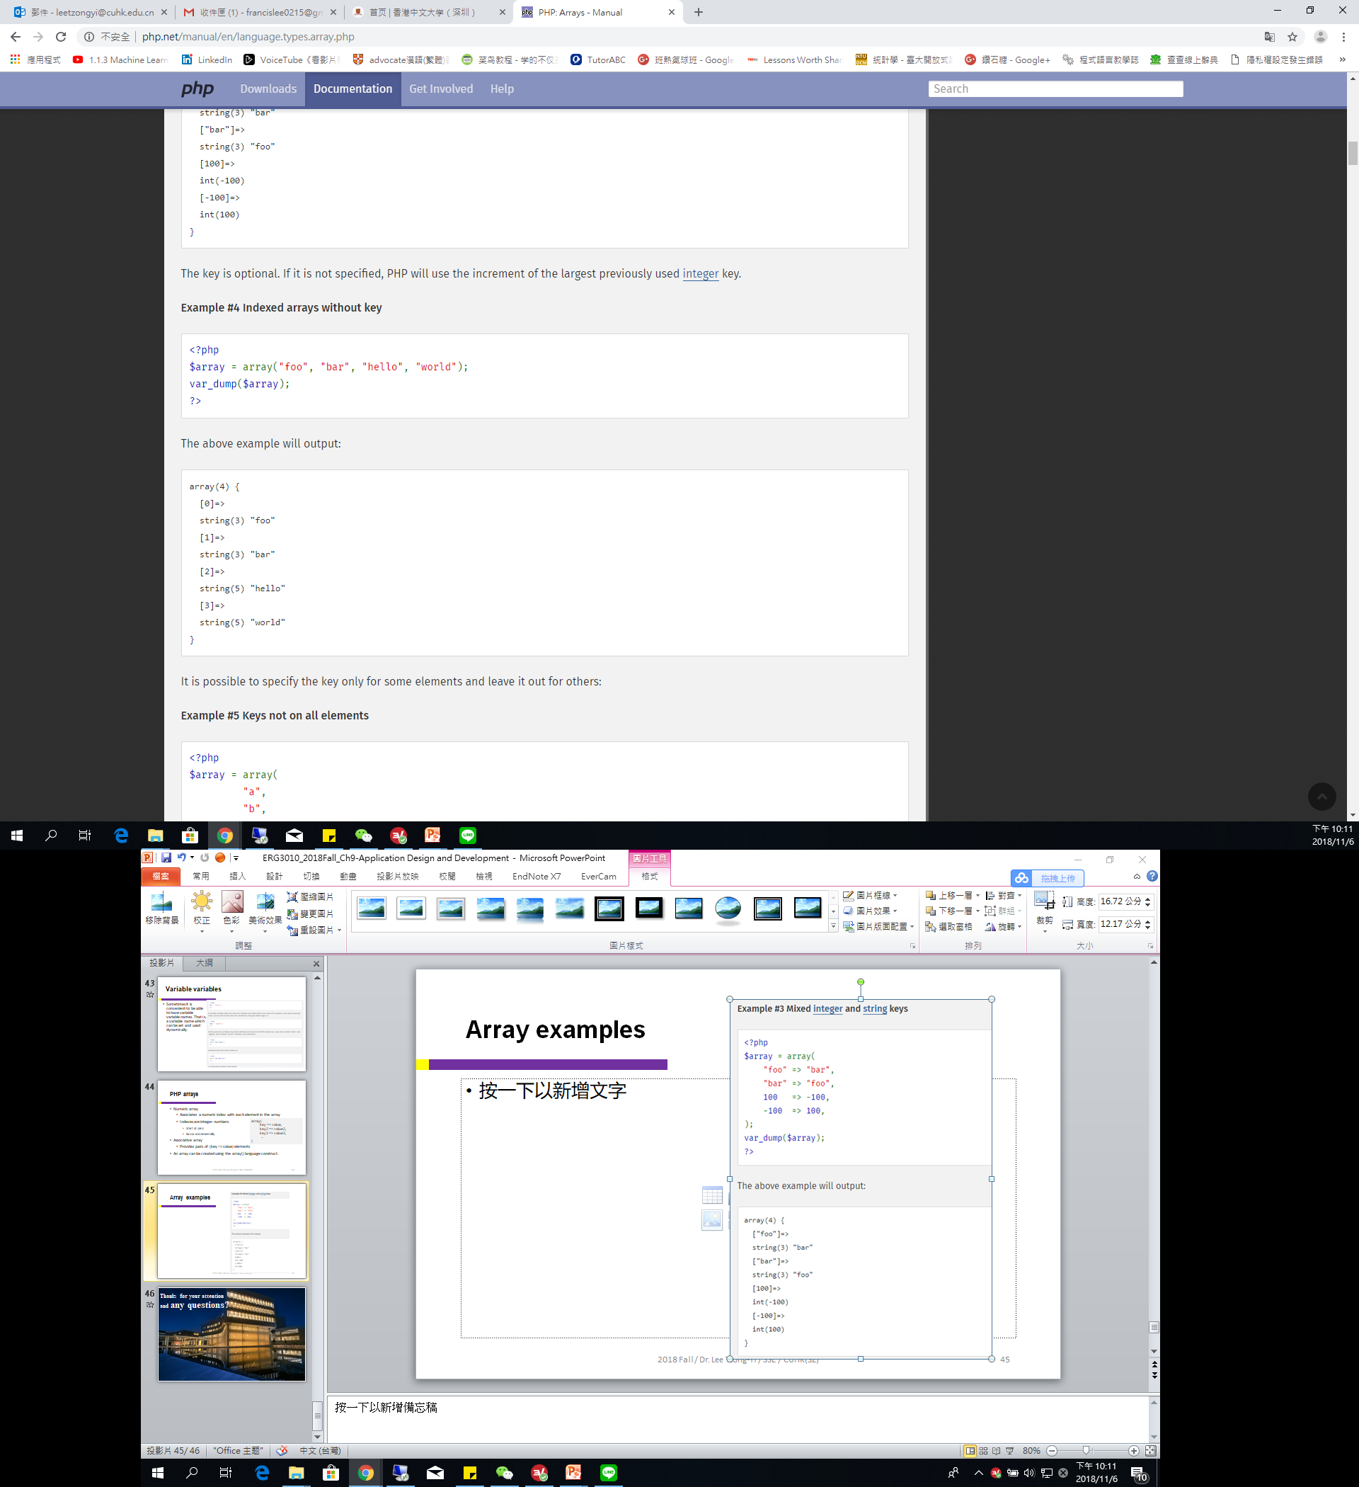
Array examples

Slide 35

Thank you and
any questions?

